Slide 1
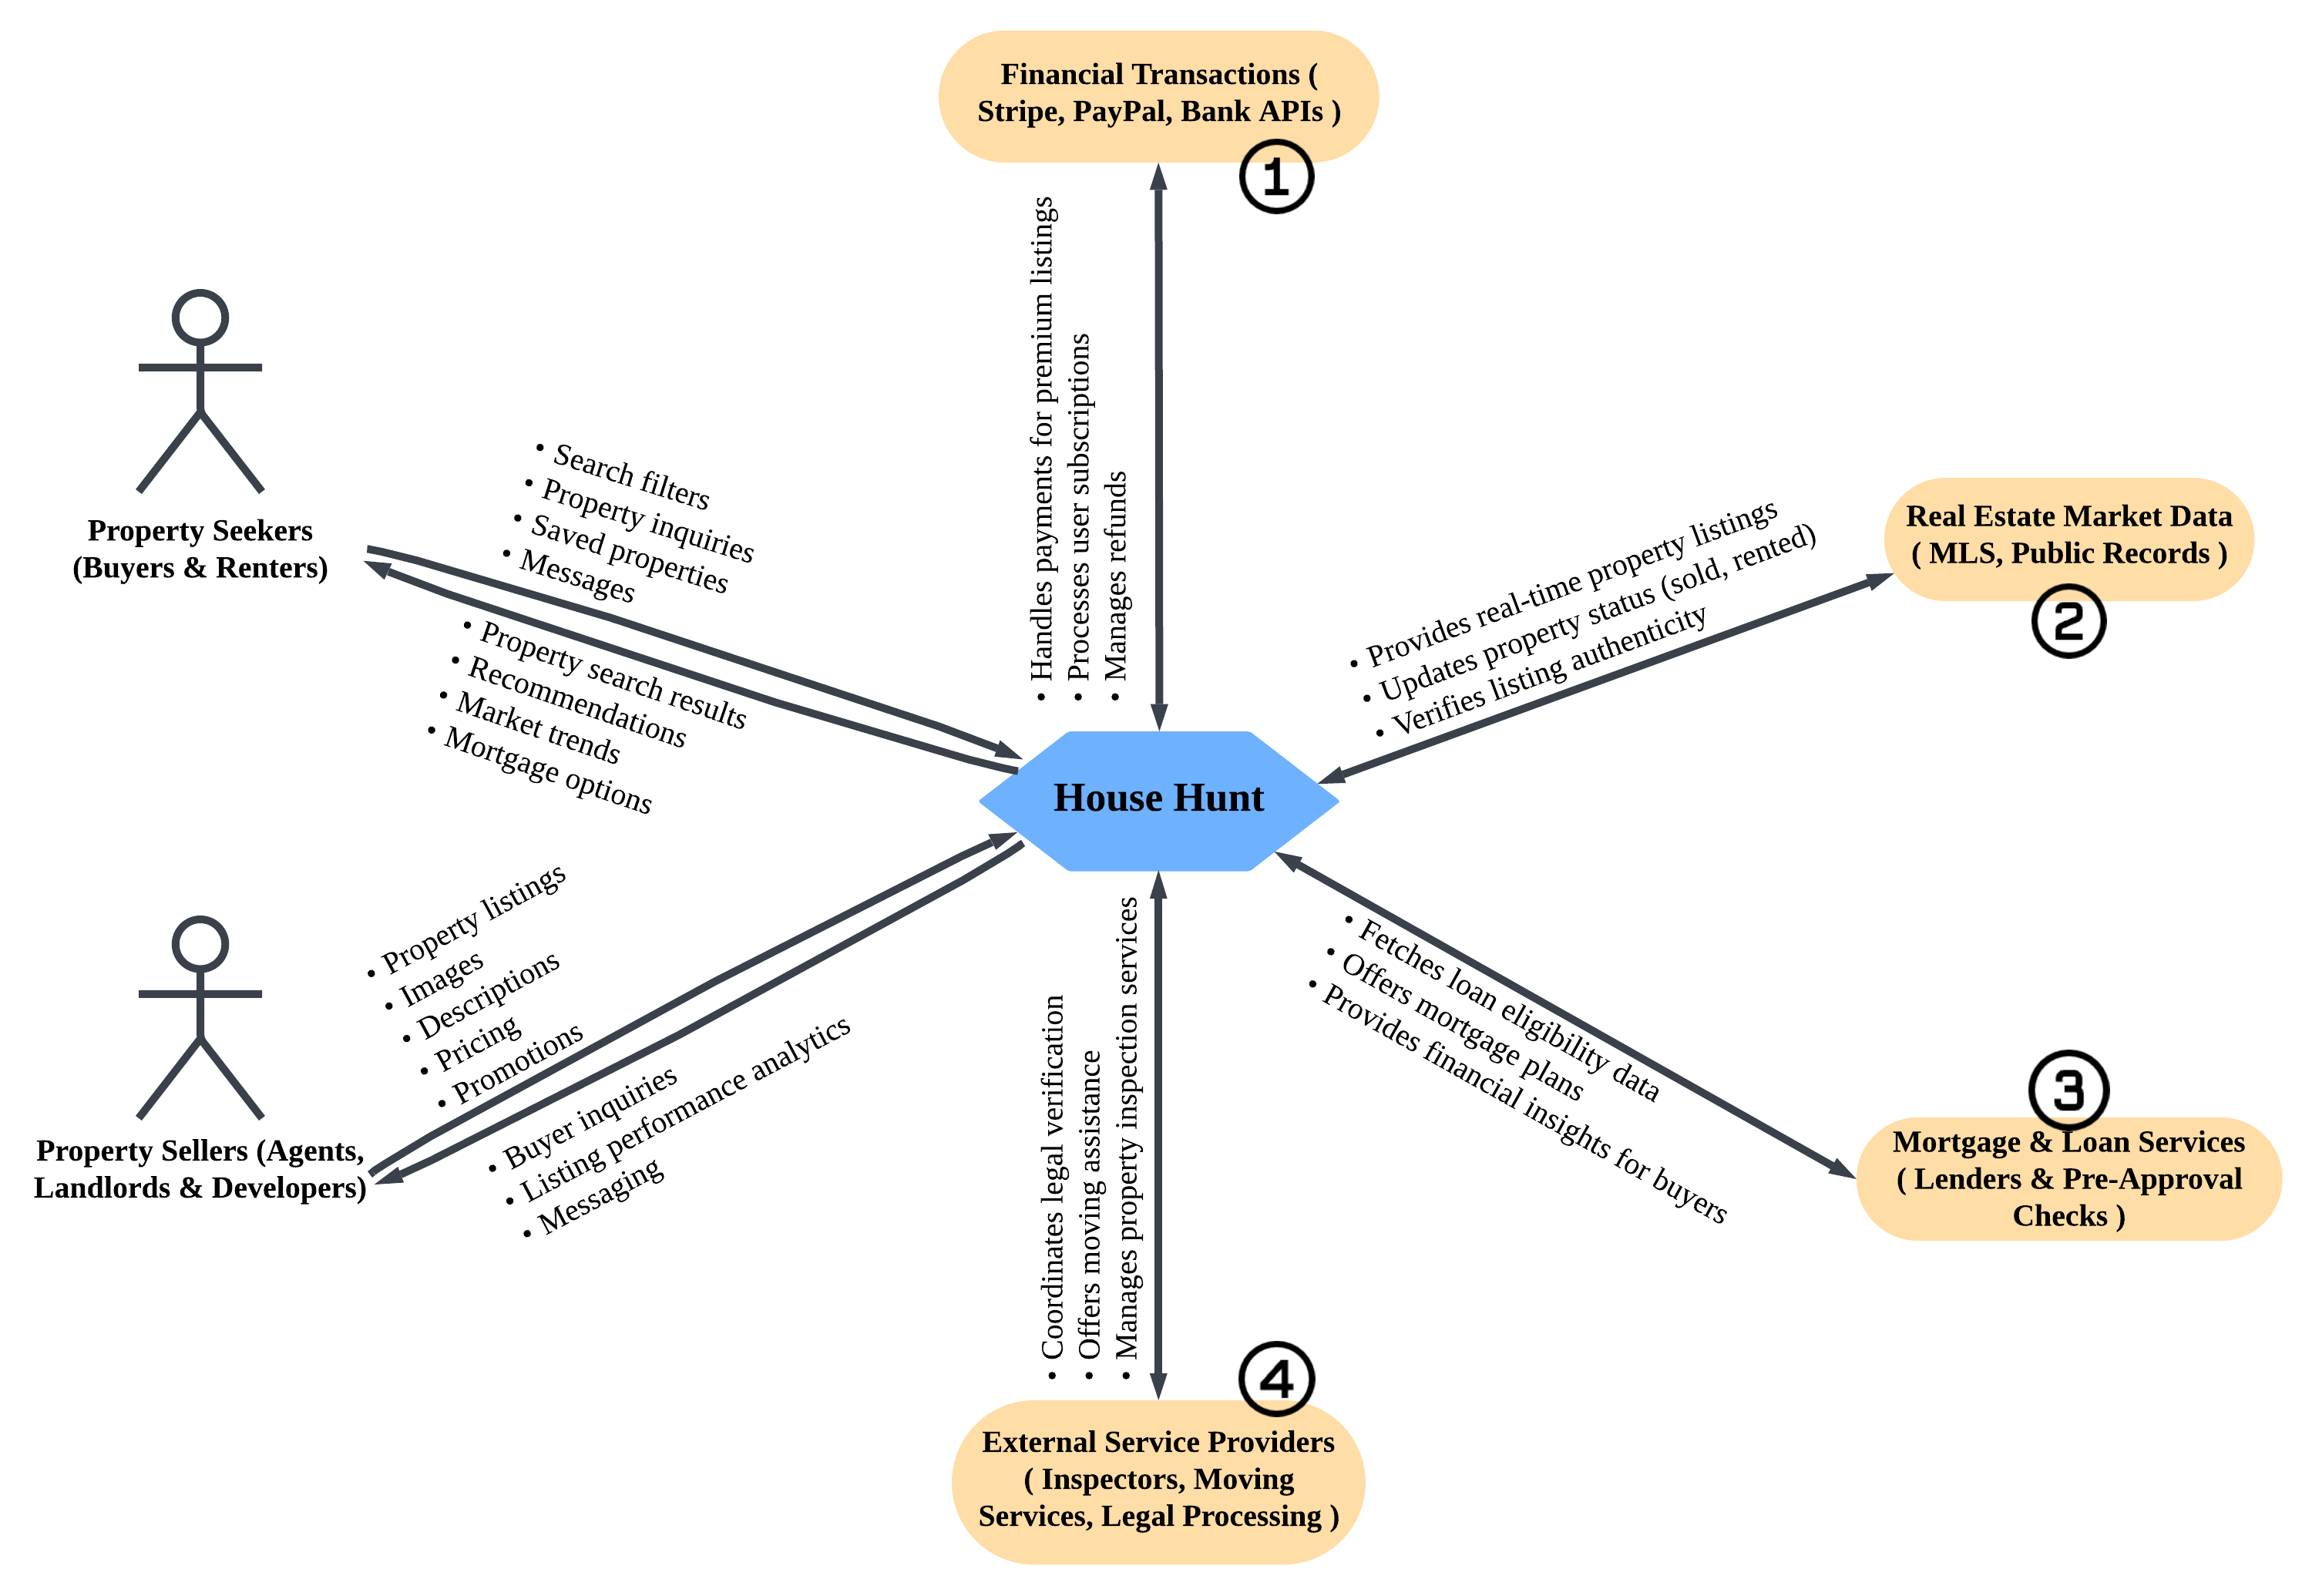
House Hunt Context Diagram

Slide 2
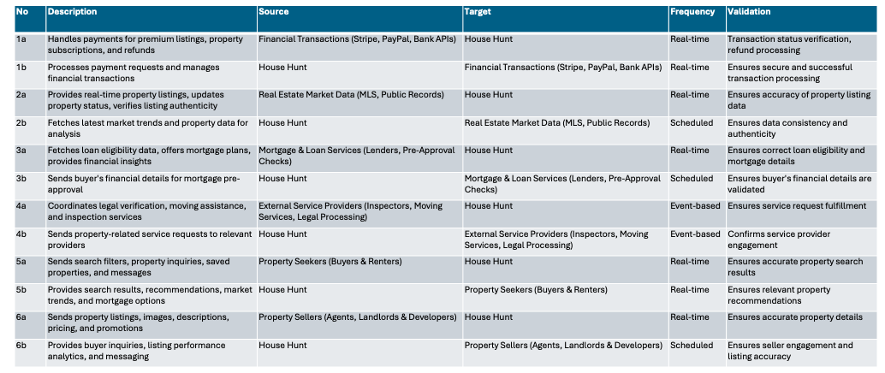
System Interface Table

